Slide 1
Machine Reading
 | Anselmo Peñas UNED NLP & IR Group nlp.uned.es

Slide 2
What’s this talk about?
Why are we so good understanding language?

Slide 3
What’s this talk about?
To know
  Be aware of a specific piece of information
    So you can use it
      In particular, to understand language.
To understand language
  Make sense of language (interpret)
    So you convert it into a piece of information
      that you are aware of.

Slide 4
Knowledge - Understanding dependence
We “understand” because we “know”
Capture ‘Background Knowledge’ from text collections
‘Understand’ language
Reading cycle

Slide 5
What’s this talk about?
How to test knowledge?
How to test knowledge acquired through language?
  Answering Questions

Slide 6
Outline
Machine Reading
Limitations of supervised Information Extraction
From Micro-reading to Macro-reading: the semi-supervised approach
Open Machine Reading: the unsupervised approach
Inference with Open Knowledge
Evaluation

Slide 7
Reading Machine
Structured
Query
Reasoning
Machine
Answer
Text
Reading Machine
A machine that produces
machine operable representations of texts

Slide 8
Why a Reading Machine?
The majority of human knowledge is encoded in text
Much of this text is available in machine-readable formats
Finding machine operable representations of texts opens the door to the automatic manipulation of vast amounts of knowledge
There is a big industry awaiting this event

Slide 9
Why now?
A change in the paradigms of Computational Semantics
  Conceptualizing content is not in the form of symbols
  but in the form of statistical distributions
The power to capture the huge amount of background knowledge
  needed to read a single document

Slide 10
Machine Reading Program
Target Ontology
Phase II first attempt
Representation according to the Target Ontology
Textual Documents
Reading
Machine
Reasoning
Machine
Questions and Answers are expressed according to a Target Ontology
The Target Ontology changes with the domain
Ideally, is an input to the MR system
Query
Answer

Slide 11
Representation for reasoning
Player
MemberOf
Event_Game
Team
homeTeam
agentOf
Event_Scoring
agentOf
awayTeam
hasProperty
Measure
loosingTeam
hasProperty
winningTeam
Target Ontology
Event_Play
Event_Final_Scoring
loosingScore
Score
winningScore

Slide 12
Query in a Target Ontology
Query 20011: Who killed less than 35 people in Kashmir?
  :- 'HumanAgent'(FileName, V_y),
  killingHumanAgent(FileName, V_x, V_y),
  'HumanAgentKillingAPerson'(FileName, V_x),
  personGroupKilled(FileName, V_x, V_group),
  'PersonGroup'(FileName, V_group),
  'Count'(FileName, V_count),
  value(FileName, V_count, 35),
  numberOfMembersUpperBound(FileName, V_group, V_count),
  eventLocationGPE(FileName, V_x, 'Kashmir').

Slide 13
Representation gap
Target Ontology is oriented to express the QA language
An extension is needed to enable reasoning: Reasoning Ontology
Both are far from text
We need several levels of intermediate representations
And mappings between them

Slide 14
Mapping between representations
Textual Documents
Reading Representation
Reasoning Representation
QA Representation
Reading Ontology
Reasoning Ontology
Target Ontology
Domain independent
Domain dependent
Domain dependent

Slide 15
Outline
Machine Reading
Limitations of supervised Information Extraction
From Micro-reading to Macro-reading: the semi-supervised approach
Open Machine Reading: the unsupervised approach
Inference with Open Knowledge
Evaluation

Slide 16
Reading Machine v.1
Information Extraction
Supervised Learning
Textual Documents
Reading Representation
Reasoning Representation
QA Representation
Reading Ontology
Reasoning Ontology
Target Ontology
Categories and relations used by the IE engine

Slide 17
Supervised IE
Learn a direct mapping between the text and the ontology
    Categories/classes, instances
    Relations
Need of many annotated examples
    For each category, relation
    For each domain
Speed up annotation
    Active Learning

Slide 18
Not good enough
Conjunctive queries
Query performance is product of IE performance for each entity and relation in the query
Will the Reasoning Machine recover from that?
IE F1 | Entities and relations in the query
0.9 | 'HumanAgent'(FileName, V_y),
0.8 | killingHumanAgent(FileName, V_x, V_y),
0.9 | 'HumanAgentKillingAPerson'(FileName, V_x),
0.8 | personGroupKilled(FileName, V_x, V_group),
0.9 | 'PersonGroup'(FileName, V_group), 'Count'(FileName, V_count), value(FileName, V_count, 35), numberOfMembersUpperBound(FileName, V_group, V_count),
0.9 | eventLocationGPE(FileName, V_x, 'Kashmir').
0.42 | Upper bound Performance

Slide 19
Local versus Global
Good performance in local decisions is not enough
  Texts are never 100% explicit
  Relations are expressed in unlearned ways
  You’ll miss some relations
  Critical in conjunctive queries

Slide 20
Local versus Global
We need global approaches
  Joint models?
    E.g.: NER and Relation Extraction?
    Still inside a single document
  Can we leverage redundancy in millions of documents?

Slide 21
Outline
Machine Reading
Limitations of supervised Information Extraction
From Micro-reading to Macro-reading: the semi-supervised approach
Open Machine Reading: the unsupervised approach
Inference with Open Knowledge
Evaluation

Slide 22
Local versus Global
What do we want?
Extract facts from a single given document?
    Micro-reading
Why a single doc?
    Depends on the final application scenario
Or do we want just extract facts?
    E.g. populate ontologies
Then, Can we leverage redundancy?

Slide 23
Macro-reading
(Tom Mitchell)
Leverage redundancy on the web
“Target” reading to populate a given ontology
Use coupled semi-supervised learning algorithms
Seed learning using Freebase, DBpedia

Slide 24
Semi-supervised Bootstrap
Bootstrapping
Start with few seeds
Find some patterns
Obtain new seeds
Find new patterns
…
Degenerates fast

Slide 25
Semi-Supervised Bootstrap Learning
Extract cities:
Paris
Pittsburgh
Seattle
Cupertino
San Francisco
Austin
denial
anxiety
selfishness
Berlin
Seeds / instances
patterns
mayor of arg1
live in arg1
arg1 is home of
traits such as arg1
Example from Tom Mitchell

Slide 26
Alternative 1: coupled learning
Coupled semi-supervised learning
  Category/class and relation extractors
  Cardinality of the relation
  Compatible / mutual exclusive categories
  Category subset / superset / orthogonal
  …

Slide 27
Alternative 1: coupled learning
Examples
Category and relation extractors
    John, lecturer at the Open University, …
  One classifier
    Lecturer at -> employee_of
  Three coupled classifiers
    John -> type_employee
    Open University -> type_company
    Lecturer at -> employee_of(type_employee, type_company)

Slide 28
Alternative 1: coupled learning
Examples
Cardinality of the relation
    Cardinality(spouse(x,y,timestamp))={0,1}
  If cardinality is 1
    Chose most probable as positive example
    Use the rest as negative examples

Slide 29
Alternative 2: More seeds
Freebase
DBPedia
No bootstrap
Learn models instead of patterns
Use in combination with coupling

Slide 30
Reading attached to the ontology
Micro-reading take advantage of the ontology
  Known instances and their categories
  Subset /superset relations
  Typed relations
Macro-reading is beyond the sum of micro-readings
    Coupling

Slide 31
Drop the ontology?
But, What do we want?
  Populate ontologies?
    Depends on the target application
  Or increase the number of beliefs available to our machine?
    Must those beliefs be targeted to an ontology?

Slide 32
Ontologies
  Artificial
  Predefined set of categories and relations
    loosingTeam
    eventFinalScoring
  Maybe too far from natural language
  Impossible mapping without some supervision

Slide 33
Ontologies
  Enable formal inference
    Specific-domain knowledge-based inferences
    Pre-specified with lots of human effort
    Machine assisted
  Are they all the inferences we need?
    Not for the purposes of reading

Slide 34
Outline
Machine Reading
Limitations of supervised Information Extraction
From Micro-reading to Macro-reading: the semi-supervised approach
Open Machine Reading: the unsupervised approach
Inference with Open Knowledge
Evaluation

Slide 35
So far…
From IE to Machine Reading
  Corpus C
  Background beliefs B
  Yield a renewed set of beliefs B’
  Reading(C) + B -> B’
Use B’ for inference in next reading cycle

Slide 36
Drop the Ontology
So, What if there is no target ontology?
  How to express / represent beliefs?
  How to make inferences?

Slide 37
Toward Open Machine Reading
  Open Knowledge Extraction (Schubert)
    KNEXT
  Open Information Extraction (Etzioni)
    TextRunner
  Followers
    DART (P. Clark)
    BKB (A. Peñas)
    IBM PRISMATIC (J. Fan)

Slide 38
Toward Open Machine Reading
How to represent beliefs?
We shouldn’t ignore what Reasoning Machines are used to work with

Slide 39
Representation
I can make graphs!
I like graphs
Do you like syntactic dependencies?
Well…
Question
Reasoning
Machine
Answer
?
Reading Machine
Text
Reasoning Ontology
Target Ontology

Slide 40
Representation
Are typed syntactic dependencies a good starting point?
  Is it possible to develop a set of “semantic dependencies”?
  How far can we go with them?
  Could we share them across languages?
  What’s a semantic dependence? A probability distribution?
Can we have a representation of the whole document instead sentence by sentence?

Slide 41
What else?
Silly machine…
What about person / organization / location / other?
I like entities and classes
I have entities and classes!
Question
Reasoning
Machine
Answer
?
Reading Machine
Text
Reasoning Ontology
Target Ontology

Slide 42
Classes
Easy ones
  Entity
    Named
      Person
      Organization
      Location
      Other
    Date
    Time
    Measure
      Distance
      Weight
      Height
      Other
    …
Not easy ones
  The rest of words
  (almost)
  Skip all philosophical argue

Slide 43
Classes
Sure!
This is about US football
Can you help me?
Great…
Question
Reasoning
Machine
Answer
?
Reading Machine
Text
Reasoning Ontology
Target Ontology
Maybe I should read something about US football

Slide 44
Classes from text
Do texts point out classes? Of course
What classes? The relevant classes for reading
Uhm… this could be interesting…
Just small experiment:
  Parse 30,000 docs. about US football
  Look for these dependencies
NNP
NNP
NNP
nn
appos
be
NN
NN
NN

Slide 45
Most frequent has-instance
334:has_instance:[quarterback:n, ('Kerry':'Collins'):name].
306:has_instance:[end:n, ('Michael':'Strahan'):name].
192:has_instance:[team:n, 'Giants':name].
178:has_instance:[owner:n, ('Jerry':'Jones'):name].
151:has_instance:[linebacker:n, ('Jessie':'Armstead'):name].
145:has_instance:[coach:n, ('Bill':'Parcells'):name].
139:has_instance:[receiver:n, ('Amani':'Toomer'):name].
…

Slide 46
Most frequent classes
15457 quarterback
12395 coach
7865 end
7611 receiver
6794 linebacker
4348 team
4153 coordinator
4127 player
4000 president
3862 safety
3722 cornerback
3479 (wide:receiver)
3344 (defensive:end)
3265 director
3252 owner
2870 (tight:end)
2780 agent
2291 guard
2258 pick
2177 manager
2138 (head:coach)
2082 rookie
2039 back
1985 (defensive:coordinator)
1882 lineman
1836 (offensive:coordinator)
1832 tackle
1799 center
1776 (general:manager)
1425 fullback
1366 (vice:president)
1196 backup
1193 game
1140 choice
1102 starter
1100 spokesman
1083 (free:agent)
1006 champion
990 man
989 son
987 tailback
…

Slide 47
Classes from text
Find more ways to point out a class in text?
  Now you have thousands of seeds
  Bootstrap!
  But remember, coupled

Slide 48
Classes
What a mess! Flat, redundant…! Where are gameWinner, safetyPartialCount, …?
I have these classes!
What?
Question
Reasoning
Machine
Answer
?
Reading Machine
Text
Reasoning Ontology
Target Ontology

Slide 49
Relations
Ok, let’s move on… Show me the relations you have
gameWinner a class!? Come on!
Relations?
Question
Reasoning
Machine
Answer
?
Reading Machine
Text
Reasoning Ontology
Target Ontology

Slide 50
Relations
Tom, ehm… What’s a relation?
Well… certainly, a relation is a n-tuple…
... n-tuple…
Like verb structures?
Uhm… this could be interesting…
Just small experiment:
  Take the 30,000 docs. about US football and look for:
VB
VB
arg0
arg1
arg0
prep
arg1
NN
NN
NN
NN
NN

Slide 51
Extraction of propositions
Patterns over dependency trees
  prop( Type, Form : DependencyConstrains : NodeConstrains ).
Examples:
  prop(nv, [N,V] : [V:N:nsubj, not(V:_:'dobj')] : [verb(V)]).
  prop(nvnpn, [N1,V,N2,P,N3]:[V:N2:'dobj', V:N3:Prep, subj(V,N1)]:[prep(Prep,P)]).
  prop(has_value, [N,Val]:[N:Val:_]:[nn(N), cd(Val), not(lemma(Val,'one'))]).

Slide 52
Most frequent propositions
nvn:[person:n, do:v, thing:n]:1530.
nvn:[group:n, do:v, thing:n]:1264.
nvn:[group:n, win:v, game:n]:960.
nvn:[person:n, tell:v, person:n]:902.
nvn:[person:n, catch:v, pass:n]:814.
nvn:[group:n, have:v, chance:n]:656.
nvn:[person:n, miss:v, game:n]:580.
nvn:[person:n, throw:v, pass:n]:567.
nvn:[group:n, have:v, lot:n]:551.
nvn:[person:n, do:v, job:n]:490.
nvn:[group:n, lose:v, game:n]:482.
nvn:[person:n, have:v, problem:n]:479.
nvn:[person:n, tell:v, group:n]:473.
nvn:[person:n, throw:v, interception:n]:465.
nvn:[group:n, play:v, game:n]:464.
Considering pronouns
  Person <- he, she
  Thing <- it
  Group <- we, they, us

Slide 53
Most frequent propositions
nvn:[team:n, win:v, game:n]:297.
nvn:[team:n, have:v, record:n]:212.
nvn:[team:n, lose:v, game:n]:166.
nvn:[touchdown:n, give:v, lead:n]:160.
nvn:[team:n, play:v, game:n]:154.
nvn:[goal:n, give:v, lead:n]:154.
nvn:[ (field:goal):n, give:v, lead:n]:150.
nvn:[team:n, make:v, playoff:n]:146.
nvn:[team:n, win:v, championship:n]:136.
nvn:[touchdown:n, give:v, ((0: - : 0):lead):n]:135.
nvn:[goal:n, give:v, ((0: - : 0):lead):n]:124.
nvn:[ (field:goal):n, give:v, ((0: - : 0):lead):n]:123.
nvn:[offense:n, score:v, touchdown:n]:118.
Ignoring pronouns

Slide 54
Most frequent “relations”
A relation is a n-tuple between instances of certain type
  I was playing with NNPs as instances…
Let’s generalize and aggregate:
  Marino -> NAME
  Bulger -> NAME
  Jones -> NAME
  …

Slide 55
Most frequent “relations”
nvn:['NAME', beat:v, 'NAME']:3884.
nvn:['NAME', catch:v, pass:n]:2567.
nvn:['NAME', play:v, 'NAME']:2382.
nvn:['NAME', lead:v, 'NAME']:2285.
nvn:['NAME', score:v, touchdown:n]:2261.
nvn:['NAME', throw:v, pass:n]:2107.
nvn:['NAME', win:v, game:n]:2010.
nvn:['NAME', replace:v, 'NAME']:1971.
nvn:['NAME', say:v, 'NAME']:1945.
nvn:['NAME', have:v, 'NAME']:1866.
nvn:['NAME', win:v, 'NAME']:1747.
nvn:['NAME', sign:v, 'NAME']:1740.
nvn:['NAME', defeat:v, 'NAME']:1663.
nvn:['NAME', hit:v, 'NAME']:1446.
nvn:['NAME', kick:v, goal:n]:1433.
Now
I know instance classes
I know propositions involving instances
Let’s find the probability of the classes given a proposition

Slide 56
Most probable typed relations
nvn:['NAME', throw:v, pass:n]:[quarterback]:0.00116408907425231.
nvn:['NAME', catch:v, pass:n]:[receiver]:0.000947483419496505.
nvn:['NAME', throw:v, (touchdown:pass):n]:[quarterback]:0.000767205964030132.
nvn:['NAME', throw:v, interception:n]:[quarterback]:0.000415367155661766.
nvn:['NAME', catch:v, pass:n]:[(wide:receiver)]:0.000406047565796885.
nvn:['NAME', say:v, linebacker:n]:[linebacker]:0.000395901727835594.
nvn:['NAME', rank:v, (no:'.'):n]:[(no:'.')]:0.000392502869262291.
nvn:['NAME', rank:v, (0:no:'.'):n]:[(no:'.')]:0.000392502869262291.
nvn:['NAME', complete:v, pass:n]:[quarterback]:0.000390269288924688.
nvn:['NAME', catch:v, (0:pass):n]:[receiver]:0.000346249735543358.
nvn:['NAME', catch:v, pass:n]:[end]:0.00033397730214679.
nvn:['NAME', throw:v, ((0: - : yard):pass):n]:[quarterback]:0.000304392988179183.
nvn:['NAME', have:v, sack:n]:[end]:0.000297055408474171.
nvn:['NAME', intercept:v, pass:n]:[safety]:0.000292011905223431.

Slide 57
Relations between classes
Now I can ask about the relations between classes
Quarterback & receiver
nvn:['NAME', hit:v, 'NAME']:[quarterback, receiver]:3.67432997918756e-06.
nvn:['NAME', find:v, 'NAME']:[quarterback, receiver]:1.8192935712796e-06.
nvnpn:['NAME', complete:v, pass:n, to:in, 'NAME']:[quarterback, receiver]:1.4512783860507e-06.
nvnpn:['NAME', throw:v, pass:n, to:in, 'NAME']:[quarterback, receiver]:1.37642726590848e-06.
nvnpn:['NAME', catch:v, pass:n, from:in, 'NAME']:[receiver, quarterback]:1.16492444555009e-06.
nvnpn:['NAME', throw:v, (touchdown:pass):n, to:in, 'NAME']:[quarterback, receiver]:1.0606850217847e-06.
If there is only one relevant relation between them, they are paraphrases

Slide 58
Relations between classes
But you can have many relevant relations between same classes
Team and game
  nvn:['NAME', win:v, game:n]:[team]:9.69097313067351e-05.
  nvn:['NAME', lose:v, game:n]:[team]:5.96928038789563e-05.
  nvn:['NAME', play:v, game:n]:[team]:2.7232092783388e-05.
  nvn:['NAME', have:v, game:n]:[team]:2.5404025345459e-05.
  nvn:['NAME', enter:v, game:n]:[team]:1.32010748425686e-05.
  nvn:['NAME', (not:win):v, game:n]:[team]:5.77931930517973e-06.
  nvn:['NAME', forfeit:v, game:n]:[team]:5.30734251201793e-06.
  nvn:['NAME', tie:v, game:n]:[team]:3.95409472849798e-06.
  nvn:['NAME', reach:v, game:n]:[team]:3.66152627590672e-06.
  nvn:['NAME', average:v, game:n]:[team]:3.45676070239657e-06.
  nvnpn:['NAME', extend:v, streak:n, to:in, game:n]:[team]:3.29470336174047e-06.
How to cluster different realizations of the same relation?
[Research question]

Slide 59
Inferring entity classes
Now, when I see something (named) doing things, I can guess its class
Culpepper directed a 15-play drive
  nvn:['NAME', direct:v, drive:n]:[quarterback]:3.37813951038364e-05.
  nvn:['NAME', direct:v, drive:n]:[backup]:2.98954603541518e-06.
  nvn:['NAME', direct:v, drive:n]:[man]:1.56144396948542e-06.
  nvn:['NAME', direct:v, drive:n]:[freshman]:1.48171220798502e-06.
  nvn:['NAME', direct:v, drive:n]:[passer]:1.3913157132247e-06.
And when I see it doing many things in a document, I can aggregate the evidence on its class. How?
[Research question]

Slide 60
Propositions into axioms
“Can we axiomatize this?”, asked Jerry
Why not?
P(quarterback, throw, pass)=0.0011
  P(quarterback | throw, pass) = p
  throw(x,y), pass(y) -> quarterback(x) | p

Slide 61
Relations between events
“Can you find the ways to express causality?”, asked Rutu
Why not? Give me a seed
Touchdown & victory
  NVN 14 'touchdown':'give':'victory'
  NVN 11 'touchdown':'seal':'victory'
  NVN 4 'touchdown':'secure':'victory‘

Slide 62
Relations between events
Give
  NVN 136 'touchdown':'give':'lead'
  NVN 130 'goal':'give':'lead'
  NVN 85 'pass':'give':'lead'
Seal
  NVN 12 'interception':'seal':'victory'
  NVN 11 'touchdown':'seal':'victory'
  NVN 6 'pass':'seal':'victory‘
Secure
  NVN 5 'victory':'secure':'title'
  NVN 4 'group':'secure':'title'
  NVN 4 'victory':'secure':'championship'

Slide 63
Relations between events
Set_up
  NVN 25 'interception':'set_up':'touchdown'
  NVN 20 'pass':'set_up':'touchdown'
  NVN 19 'interception':'set_up':'goal'
  NVN 14 'pass':'set_up':'goal'
  NVN 14 'return':'set_up':'touchdown'
  NVN 12 'interception':'set_up':'score'
  NVN 11 'fumble':'set_up':'touchdown'
  NVN 11 'run':'set_up':'touchdown'
  NVN 10 'person':'set_up':'touchdown'
  NVN 9 'return':'set_up':'goal'
  NVN 9 'pass':'set_up':'run'
  NVN 9 'interception':'set_up':'run'
  NVN 9 'run':'set_up':'goal'

Slide 64
IE approach
IE
Reading Machine?
Textual Documents
Reading Representation
Reading Ontology
Entities and relations used by the IE engine

Slide 65
A Reading Machine more like this
Aggregation and generalization
Textual Documents
Reading
Cycle
Background Knowledge
Reading
Inference

Slide 66
Bridging the gap
What if we want a target ontology?
Reasoning with representations closer to the text
Representations of text closer to the Reasoning Ontology

Slide 67
The Reading Machine
Aggregation and generalization
Textual Documents
Reading
Cycle
Reading
Background Knowledge
Enrichment
Mapping
Question
Reasoning
Machine
Answer
Seeding
Target Ontology
Reasoning Ontology
Linking

Slide 68
The Reading Machine
Iterate over big amounts of text
  Process texts up to reified logic forms
  Generalization and aggregation of frequent structures in the logic forms
    Estimation of their probability distributions
    Dumping intermediate Background Knowledge Bases (BKB)
  Enrichment of initial text representations (BKBs are then used to fill the knowledge gaps)
  Repeat with the enriched representation of texts

Slide 69
Outline
Machine Reading
Limitations of supervised Information Extraction
From Micro-reading to Macro-reading: the semi-supervised approach
Open Machine Reading: the unsupervised approach
Inference with Open Knowledge
Evaluation

Slide 70
Inference with Open Knowledge
Open Machine Reading
  How to make inferences?
  What inferences?
This connects with
  Textual Entailment and Paraphrasing
  Question Answering (not structured)
  …

Slide 71
Enrichment
Why is so difficult to reason about a single text?
Because almost all the knowledge you need to interpret the text is outside the text, assumed as reader’s background knowledge
      We need to add the missing information: Enrichment
          the process of adding explicitly to a text’s representation the information that is either implicit or missing in the text

Slide 72
Text omits information
San Francisco's Eric Davis intercepted a Steve Walsh pass on the next series to set up a seven-yard Young touchdown pass to Brent Jones.

Slide 73
Make explicit implicit information
San Francisco's Eric Davis intercepted a Steve Walsh pass on the next series to set up a seven-yard Young touchdown pass to Brent Jones.
Implicit | (More) explicit
San Francisco’s Eric Davis | Eric Davis plays for San Francisco E.D. is a player, S.F. is a team
Eric Davis intercepted pass₁ | -
Steve Walsh pass₁ | Steve Walsh threw pass₁ Steve Walsh threw interception₁…
Young touchdown pass₂ | Young completed pass₂ for touchdown…
touchdown pass₂ to Brent Jones | Brent Jones caught pass₂ for touchdown

Slide 74
Make explicit implicit information
Automatic recovering of such omitted information

Slide 75
Background Knowledge Base
(NFL, US football)
?> NPN 'pass':X:'touchdown‘
NPN 712 'pass':'for':'touchdown'
NPN 24 'pass':'include':'touchdown’
…
?> NVN 'quarterback':X:'pass'
NVN 98 'quarterback':'throw':'pass'
NVN 27 'quarterback':'complete':'pass‘
…
?> NVNPN 'NNP':X:'pass':Y:'touchdown'
NVNPN 189 'NNP':'catch':'pass':'for':'touchdown'
NVNPN 26 'NNP':'complete':'pass':'for':'touchdown‘
…
?> NVN 'end':X:'pass‘
NVN 28 'end':'catch':'pass'
NVN 6 'end':'drop':'pass‘
…
?> NN NNP:’pass’
NN 24 'Marino’:'pass‘
NN 17 'Kelly':'pass'
NN 15 'Elway’:'pass’
…
?>X:has-instance:’Marino’
20 'quarterback':has-instance:'Marino'
6 'passer':has-instance:'Marino'
4 'leader':has-instance:'Marino'
3 'veteran':has-instance:'Marino'
2 'player':has-instance:'Marino'

Slide 76
Enrichment example (1)
…to set up a 7-yard Young touchdown pass to Brent Jones
Young
touchdown
Jones
nn
nn
to
pass
Young pass
  ?> X:has-instance:Young
    X=quarterback
  ?> NVN:quarterback:X:pass
    X=throw
    X=complete
pass to Jones
  ?> X:has-instance:Jones
    X=end
  ?> NVN:end:X:pass
    X=catch
    X=drop

Slide 77
Enrichment example (2)
…to set up a 7-yard Young touchdown pass to Brent Jones
Young
touchdown
Jones
throw
complete
nn
catch
drop
pass
touchdown pass
  ?> NVN touchdown:X:pass
    False
  ?> NPN pass:X:touchdown
    X=for

Slide 78
Enrichment example (3)
…to set up a 7-yard Young touchdown pass to Brent Jones
Young
touchdown
Jones
throw
complete
for
catch
drop
pass
  ?> NVNPN NAME:X:pass:for:touchdown
    X=complete
    X=catch

Slide 79
Enrichment example (4)
…to set up a 7-yard Young touchdown pass to Brent Jones
Young
touchdown
Jones
complete
for
catch
pass
Young complete pass for touchdown
Jones catch pass for touchdown

Slide 80
Enrichment
Build context for instances
Build context for dependencies
  Finding implicit predicates
Constrain interpretations

Slide 81
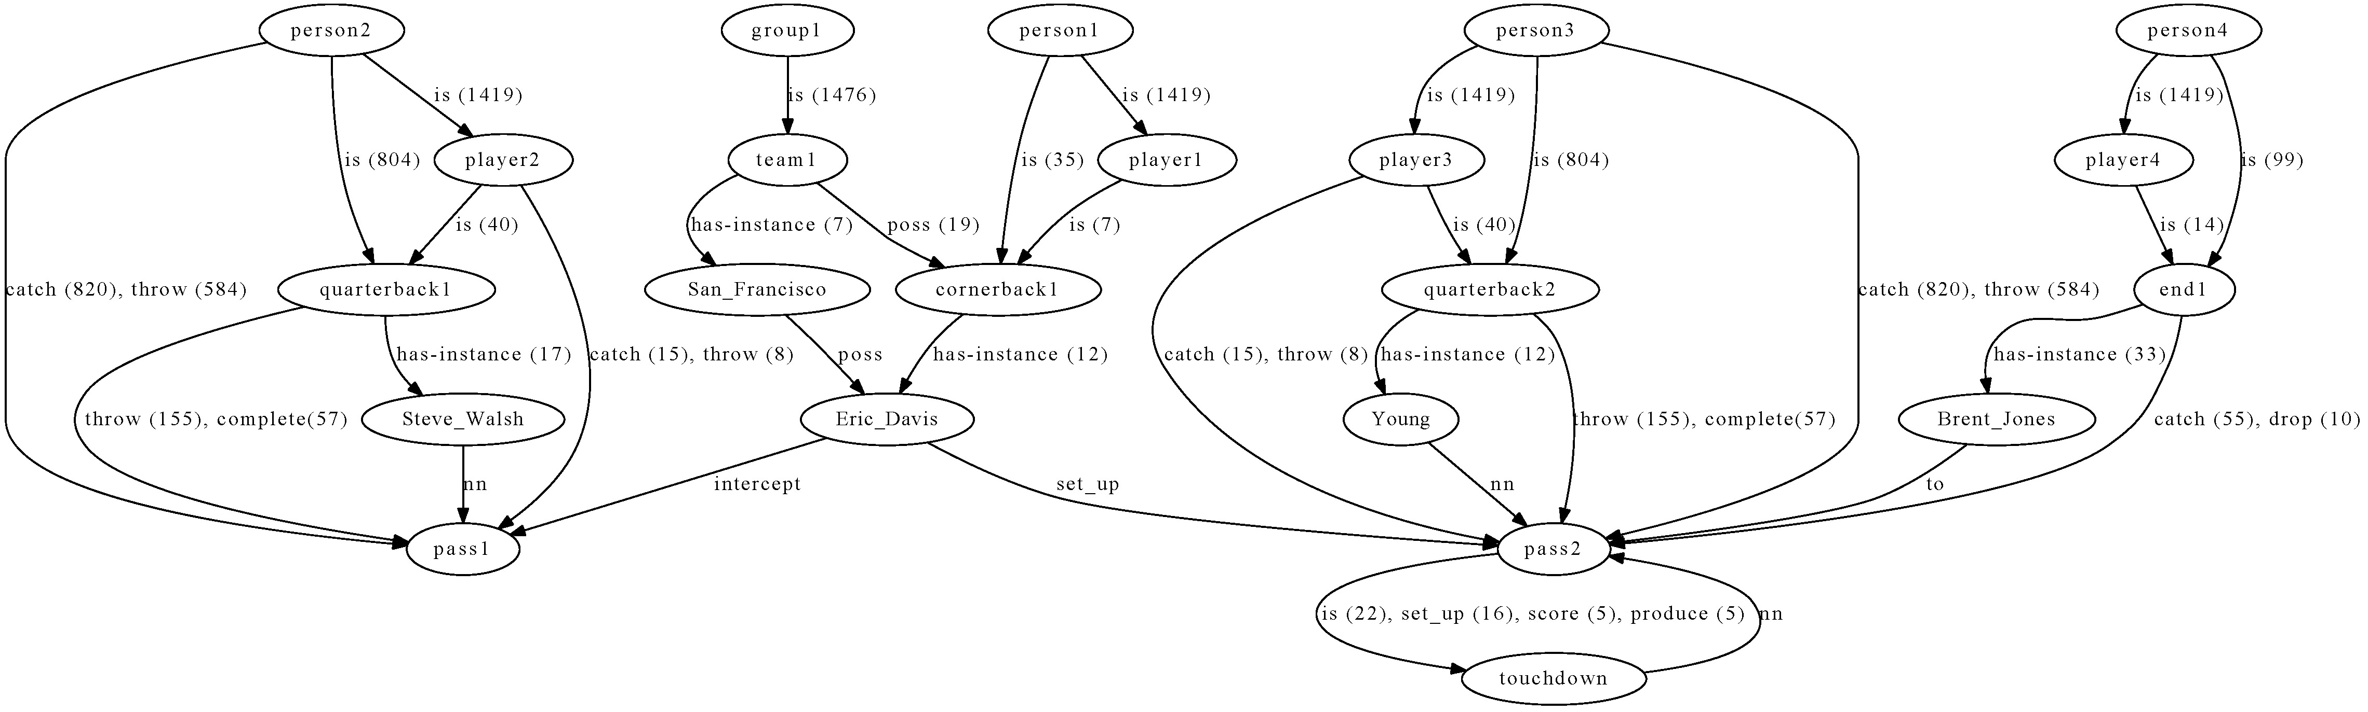
Enrichment example (5)
San Francisco's Eric Davis intercepted a Steve Walsh pass on the next series to set up a seven-yard Young touchdown pass to Brent Jones.
Before enrichment
After enrichment
complete
catch
throw
for

Slide 82
What BKBs need for enrichment? (1)
Ability to answer about instances
    Not complete population
    But allow analogy
Ability to constrain interpretations and accumulate evidence
    Several different queries over the same elements considering different structures
    Require normalization (besides parsing)

Slide 83
What BKBs need for enrichment? (1)
Ability to discover entity classes with appropriate granularity level
    Quarterbacks throw passes
    Ends catch passes
    Tag an entity as person or even player is not specific enough for enrichment
    Text frequently introduces the relevant class (appropriate granularity level) for understanding

Slide 84
What BKBs need for enrichment? (2)
Ability to digest enough knowledge adapted to the domain
    Crucial
  Approaches
    Open IE (web scale) + domain adaptation
      Shallow NLP, lack of normalization
    Reading in context (suggested here)
      Consider only documents in the same context
      Deeper NLP

Slide 85
Digest enough knowledge
  DART: general domain Proposition Store
  TextRunner: general domain Open IE (web-scale)
  BKB: Proposition Store in context
    (e.g. only 30,000 docs about American Football)
?> quarterback:X:pass
DART | TextRunner | BKB (US Football)
(no results) | (~200) threw (~100) completed (36) to throw (26) has thrown (19) makes (19) has (18) fires | (99) throw (25) complete (7) have (5) attempt (5) not-throw (4) toss (3) release

Slide 86
Digest Knowledge in the same context
(entity classes)
?> X:intercept:pass
DART | TextRunner | BKB (US Football)
(13) person (6) person/place/organization (2) full-back (1) place | (30) Early (26) Two plays (24) fumble (20) game (20) ball (17) Defensively | (75) person (14) cornerback (11) defense (8) safety (7) group (5) linebacker

Slide 87
Digest Knowledge in the same context
(ambiguity problem)
?> person:X:pass
DART | TextRunner | BKB (US Football)
(47) make (45) take (36) complete (30) throw (25) let (23) catch (1) make (1) expect | (22) gets (17) makes (10) has (10) receives (7) who has (7) must have (6) acting on (6) to catch (6) who buys (5) bought (5) admits (5) gives | (824) catch (546) throw (256) complete (136) have (59) intercept (56) drop (39) not-catch (37) not-throw (36) snare (27) toss (23) pick off (20) run

Slide 88
Different contexts, different expectations
?> person:X:pass
  NFL Context
    905:nvn:[person:n, catch:v, pass:n].
    667:nvn:[person:n, throw:v, pass:n].
    286:nvn:[person:n, complete:v, pass:n].
    204:nvnpn:[person:n, catch:v, pass:n, for:in, yard:n].
    85:nvnpn:[person:n, catch:v, pass:n, for:in, touchdown:n].
  IC Context
    6:nvn:[person:n, have:v, pass:n]
    3:nvn:[person:n, see:v, pass:n]
    1:nvnpn:[person:n, wear:v, pass:n, around:in, neck:n]
  BIO Context
    <No results>

Slide 89
Different contexts, different expectations
?> X:receive:Y
  NFL Context
    55:nvn:[person:n, receive:v, call:n].
    34:nvn:[person:n, receive:v, offer:n].
    33:nvn:[person:n, receive:v, bonus:n].
    29:nvn:[team:class, receive:v, pick:n].
  IC Context
    78 nvn:[person:n, receive:v, call:n]
    44 nvn:[person:n, receive:v, letter:n]
    35 nvn:[group:n, receive:v, information:n]
    31 nvn:[person:n, receive:v, training:n]
  BIO Context
    24 nvn:[patients:n, receive:v, treatment:n]
    14 nvn:[patients:n, receive:v, therapy:n]
    13 nvn:[patients:n, receive:v, care:n]

Slide 90
Conclusions
A context can be built on demand
  “Retrieve 30,000 relevant docs. for the one under reading”, destille background knowledge
Limiting to a specific context provides some powerful benefits
  Ambiguity is reduced
  Higher density of relevant propositions
  Different distribution of propositions across domains
  Amount of source text is reduced, allowing deeper processing such as parsing
  Specific tools for specific domains

Slide 91
Outline
Machine Reading
Limitations of supervised Information Extraction
From Micro-reading to Macro-reading: the semi-supervised approach
Open Machine Reading: the unsupervised approach
Inference with Open Knowledge
Evaluation

Slide 92
Evaluation
The evaluation of these machines is an open research question
It is also an opportunity to consolidate the community around the field

Slide 93
QA4MRE, Question Answering for Machine Reading Evaluation
Organization
  Anselmo Peñas (UNED, Spain)
  Eduard Hovy (USC-ISI, USA)
  Pamela Forner (CELCT, Italy)
  Álvaro Rodrigo (UNED, Spain)
  Richard Sutcliffe (U. Limerick, Ireland)
  Roser Morante (U. Antwerp, Belgium)
  Walter Daelemans (U. Antwerp, Belgium)
  Corina Forascu (UAIC, Romania)
  Caroline Sporleder (U. Saarland, Germany)
  Yassine Benajiba (Philips, USA)
Advisory Board 2011 (TBC 2012)
  Ken Barker, (U. Texas at Austin, USA)
  Johan Bos, (Rijksuniv. Groningen, Netherlands)
  Peter Clark, (Vulcan Inc., USA)
  Ido Dagan, (U. Bar-Ilan, Israel)
  Bernardo Magnini, (FBK, Italy)
  Dan Moldovan, (U. Texas at Dallas, USA)
  Emanuele Pianta, (FBK and CELCT, Italy)
  John Prager, (IBM, USA)
  Dan Tufis, (RACAI, Romania)
  Hoa Trang Dang, (NIST, USA)

Slide 94
Question Answering Track at CLEF
 | 2003 |  | 2004 | 2005 |  | 2006 | 2007 | 2008 | 2009 | 2010 | 2011 | 2012
QA Tasks | Multiple Language QA Main Task |  |  |  |  |  |  |  | ResPubliQA |  | QA4MRE
 |  | Temporal restrictions and lists |  |  |  | Answer Validation Exercise (AVE) |  |  | Giki CLEF |  | Negation and Modality
 |  |  |  |  |  | Real Time | QA over Speech Transcriptions (QAST) |  |  |  |  | Biomedical
 |  |  |  |  |  | WiQA |  | WSD QA

Slide 95
New setting: QA4MRE
QA over a single document:
  Multiple Choice Reading Comprehension Tests
    Forget about the IR step (for a while)
    Focus on answering questions about a single text
    Chose the correct answer
Why this new setting?

Slide 96
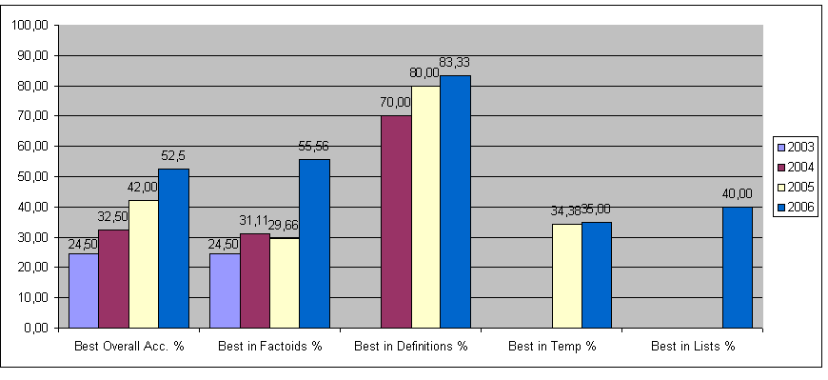
Systems performance
Upper bound of 60% accuracy
Overall
Best result
<60%
Definitions
Best result
>80%
NOT
IR approach

Slide 97
Pipeline Upper Bound
Question
Question
analysis
Passage
Retrieval
Answer
Extraction
Answer
Ranking
Answer
0.8
x
0.8
x
1.0
=
0.64
Not enough evidence
SOMETHING to break the pipeline: answer validation instead of re-ranking

Slide 98
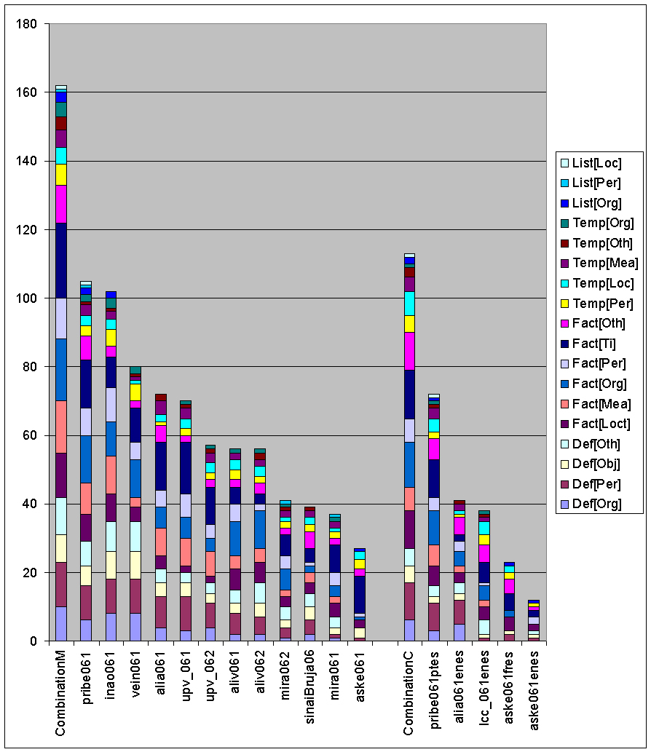
Multi-stream upper bound
Best with ORGANIZATION
Perfect combination
81%
Best with PERSON
Best with TIME
Best system 52,5%

Slide 99
Multi-stream architectures
Different systems response better different types of questions
    Specialization
    Collaboration
Question
QA sys₁
QA sys₂
SOMETHING for combining / selecting
Answer
QA sys₃
Candidate answers
QA sys_{n}

Slide 100
AVE 2006-2008
Answer Validation: decide whether to return the candidate answer or not
Answer Validation should help to improve QA
  Introduce more content analysis
  Use Machine Learning techniques
  Able to break pipelines and combine streams

Slide 101
Hypothesis generation + validation
Answer
Searching space of candidate answers
Hypothesis generation functions
+
Answer validation functions
Question

Slide 102
ResPubliQA 2009 - 2010
Transfer AVE results to QA main task 2009 and 2010
  Promote QA systems with better answer validation
QA evaluation setting assuming that
  To leave a question unanswered has more value than to give a wrong answer

Slide 103
Evaluation measure
(Peñas and Rodrigo, ACL 2011)
Reward systems that maintain accuracy but reduce the number of incorrect answers by leaving some questions unanswered
n: Number of questions
n_{R}: Number of correctly answered questions
n_{U}: Number of unanswered questions

Slide 104
Conclusions of ResPubliQA 2009 – 2010
This was not enough
We expected a bigger change in systems architecture
Validation is still in the pipeline
  IR -> QA
No qualitative improvement in performance
Need of space to develop the technology

Slide 105
2011 campaign
Promote a bigger change in QA systems architecture
QA4MRE: Question Answering for Machine Reading Evaluation
Measure progress in two reading abilities
  Answer questions about a single text
  Capture knowledge from text collections

Slide 106
Reading test
Text
Coal seam gas drilling in Australia's Surat Basin has been halted by flooding.
Australia's Easternwell, being acquired by Transfield Services, has ceased drilling because of the flooding.
The company is drilling coal seam gas wells for Australia's Santos Ltd.
Santos said the impact was minimal.
Multiple choice test
According to the text…
What company owns wells in Surat Basin?
Australia
Coal seam gas wells
Easternwell
Transfield Services
Santos Ltd.
Ausam Energy Corporation
Queensland
Chinchilla

Slide 107
Knowledge gaps
drill
Australia
is part of
I
for
II
Queensland
is part of
Company A
Well C
Company B
own | P=0.8
Surat Basin
Texts always omit information
We need to fill the gaps
Acquire background knowledge from the reference collection

Slide 108
Multilingual axioms?
Can we learn these axioms from previous reading of many texts?
  company(A,x), drill(e1,x,y), well(C,y), for(e,z), company(B,z) ->
  own(e2,z,y)
An axiom learned in one language,
Can be used to fill gaps in another language?
Why not?
How? What do we need?

Slide 109
Evaluation setting requirements
Don’t fix the representation formalism
  Semantic representation beyond sentence level is part of the research agenda
Don't build systems tuned for specific domains
  But general technologies, able to self-adapt to new contexts or topics
Evaluate reading abilities
  Knowledge acquisition
  Answer questions about a single document
Control the role of knowledge

Slide 110
Control the variable of knowledge
The ability of making inferences about texts is correlated to the amount of knowledge considered
This variable has to be taken into account during evaluation
Otherwise it is very difficult to compare methods
How to control the variable of knowledge in a reading task?

Slide 111
Sources of knowledge
Text Collection
  Big and diverse enough to acquire required knowledge
    Impossible for all possible topics
  Define a scalable strategy: topic by topic
Several topics
  Narrow enough to limit knowledge needed (e.g. Petroleum industry, European Football League, Disarmament of the Irish Republican Army, etc.)
  Reference collection per topic (10,000-50,000 docs.)
    Documents defining concepts about the topic (e.g. wikipedia)
    News about the topic
    Web pages, blogs, opinions

Slide 112
Evaluation tests (2011)
12 reading tests (4 docs per topic)
120 questions (10 questions per test)
600 choices (5 options per question)
Translated into 5 languages:
  English, German, Spanish, Italian, Romanian
  Plus Arabic in 2012
Questions are more difficult and realistic
100% reusable test sets

Slide 113
Evaluation tests (2011)
44 questions required background knowledge from the reference collection
38 required combine info from different paragraphs
Textual inferences
  Lexical: acronyms, synonyms, hypernyms…
  Syntactic: nominalizations, paraphrasing…
  Discourse: correference, ellipsis…

Slide 114
Evaluation
QA perspective evaluation
  c@1 over all 120 questions
Reading perspective evaluation
  Aggregating results test by test
Task | Registered groups | Participant groups | Submitted Runs
QA4MRE 2011 | 25 | 12 | 62 runs

Slide 115
QA4MRE 2012 Main Task
Topics
    AIDS
    Music and Society
    Climate Change
    Alzheimer (divulgative sources: blogs, web, news, …)
Languages
    English, German, Spanish, Italian, Romanian
    Arabic
new
new

Slide 116
QA4MRE 2012 Pilots
Modality and Negation
  Given an event in the text decide whether it is
    Asserted (no negation and no speculation)
    Negated (negation and no speculation)
    Speculated
  Roadmap
    2012 as a separated pilot
    2013 integrate modality and negation in the main task tests

Slide 117
QA4MRE 2012 Pilots
  Biomedical domain
    Same setting than main but
    Scientific language (require domain adaptation)
    Focus on one disease: Alzheimer (~50,000 docs)
    Give participants the background collection already processed: Tok, Lem, POS, NER, Dependency parsing
    Development set

Slide 118
QA4MRE 2012 in summary
Main task
  Multiple Choice Reading Comprehension tests
  Topics: AIDS, Music and Society, Climate Change, Alzheimer
  English, German, Spanish, Italian, Romanian, Arabic
Two pilots
  Modality and negation
    Asserted, negated, speculated
  Biomedical domain focus on Alzheimer disease
    Same format as the main task

Slide 119
Schedule
Guidelines and Samples of tests | 1st February
Release of topics and reference corpora | 1st April
Test set release | 1st June
Run submissions | 15th June
Results to the participants | 1st July
Submission of Notebook Papers | August - September
Web site: http://celct.fbk.eu/QA4MRE/

Slide 120
Conclusion
Augment the local process with global, statistical inferences that leverage redundancy and coupling
  You can target to an ontology: Macro-reading
  Or explore the unsupervised
  Integrate this idea in your tools and applications -> research
Don’t forget to evaluate: QA4MRE

Slide 121
Thanks!

